Slide 1


PMIT-6204: Cryptography & Steganography
for
3rd Semester of PMIT Program
Lecture File: 04
DES, AES & RSA Cryptosystems
Prepared by:
Professor K M Akkas Ali
akkas_khan@yahoo.com, akkas@juniv.edu
Institute of Information Technology (IIT)
Jahangirnagar University, Dhaka-1342

Slide 2
Lecture File: 04
DES, AES & RSA Cryptosystems
Objectives of this Lecture:
To introduce the components of modern block ciphers.
To discuss product ciphers and discuss between Feistel and non-Feistel ciphers.
To review a short history of DES.
To define the basic structure of DES.
To describe the details of building elements of DES.
To describe the round keys generation process.
To discuss the basic structure of AES.
To discuss the RSA cryptosystem

Slide 3
Components of a Modern Block Ciphers:
Modern block ciphers normally are keyed substitution ciphers in which the key allows only partial mappings from the possible inputs to the possible outputs.
However, modern block ciphers normally are not designed as a single unit.
To provide the required properties of a modern block cipher, such as diffusion and confusion, a modern block cipher is made of a combination of several units:
Transposition units (called P-boxes)
Substitution units (called S-boxes)
Some other units
Notes:
3

Slide 4
Components of a Modern Block Ciphers (continued…):
P-Boxes:
A P-box (permutation box) is a component in a modern block cipher that transposes bits.
Types of P-Boxes:
Three types of P-boxes are used in modern block ciphers:
Straight P-Boxes
Expansion P-Boxes
Compression P-Boxes
Notes:
4

Slide 5
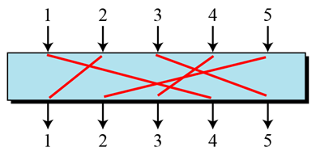
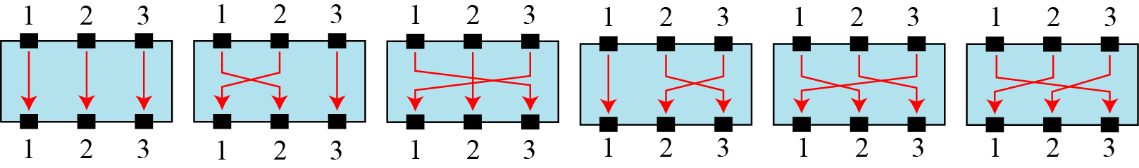
Components of a Modern Block Ciphers (continued…):
Straight P-Boxes:
A straight P-Box is a permutation which has n inputs and n outputs.
There are n! possible mappings.
Figure below shows a 5 x 5 straight P-box.
Figure: A 5x5 straight P-box
Example of all mappings for Straight P-Boxes:
Figure below shows a 3x3 straight P-box with all 6 (3!) possible mappings.
Figure: The possible mappings of a 3 × 3 Straight P-box
Notes:
5

Slide 6
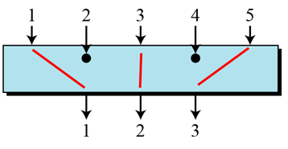
Components of a Modern Block Ciphers (continued…):
Compression P-Boxes:
A compression P-box is a P-box with n inputs and m outputs where m<n.
Some of the inputs are blocked and do not reach the output.
Figure below shows a 5 x 3 compression P-box.
Figure: A 5x3 Compression P-box
The compression P-boxes used in modem block ciphers are keyless normally, where a permutation table shows the rules for transposing bits.
Compression P-boxes are used when we need to permute bits and the same time decrease the number of bits for the next stage of encryption/decryption.
Notes:
6

Slide 7
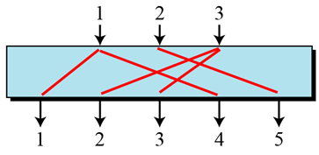
Components of a Modern Block Ciphers (continued…):
Expansion P-Boxes:
A expansion P-box is a P-box with n inputs and m outputs where m>n.
Some of the inputs are connected to more than one output.
Figure below shows a 3 x 5 expansion P-box.
Figure: A 3 x 5 Expansion P-box
The expansion P-boxes used in modem block ciphers normally are keyless, where a permutation table shows the rules for transposing bits.
Expansion P-boxes are used when we need to permute bits and the same time increase the number of bits for the next stage of encryption/decryption.
Notes:
7

Slide 8
Components of a Modern Block Ciphers (continued…):
S-Boxes:
An S-box (substitution box) can be thought of as a miniature substitution cipher.
However, an S-box can have a different number of inputs and outputs. In other words, the input to an S-box could be an n-bit word, but the output can be an m-bit word, where m and n are not necessarily the same.
Although an S-box can be keyed or keyless, modem block ciphers normally use keyless S-boxes, where the mapping from the inputs to the outputs is predetermined.
Notes:
8

Slide 9
Components of a Modern Block Ciphers (continued…):
Input-Output Relationship for a 3x2 S-Box by Table:
The following table defines the input/output relationship for an S-box of size 3 × 2.
The leftmost bit of the input defines the row; the two rightmost bits of the input define the column.
The two output bits are values on the cross section of the selected row and column.
Table: Input-Output relationship for a 3 x 2 S-box
Based on the above S-box table, an input of 010 yields the output 01. An input of 101 yields the output of 00.
Notes:
9

Slide 10
Components of a Modern Block Ciphers (continued…):
Kinds of Product Ciphers:
Modern block ciphers are all product ciphers, but they are divided into two classes:
Feistel ciphers
Non-Feistel ciphers
Feistel ciphers:
In 1973, Feistel designed a very intelligent and interesting cipher that has been used for decades. Several block ciphers are based on the Feistel structure.
This type of ciphers use both invertible and noninvertible components.
A Feistel cipher can have three types of components: self-invertible, invertible, and noninvertible.
A Feistel cipher combines all noninvertible elements in a unit (called mixer) and uses the same unit in the encryption and decryption algorithms.
The block cipher DES, IDEA, RC5 (Rivest’s Cipher) are good examples of a Feistel cipher. But Feistel design is not used in AES.
Notes:
10

Slide 11
Components of a Modern Block Ciphers (continued…):
Non-Feistel ciphers:
This type of ciphers use only invertible components.
A component in the encryption cipher has the corresponding component in the decryption cipher.
For example, S-boxes need to have an equal number of inputs and outputs to be compatible. No compression or expansion P-boxes are allowed, because they are not invertible.
In a non-Feistel cipher, there is no need to divide the plaintext into two halves as we saw in the Feistel ciphers.
The block cipher AES is a good example of a non-Feistel cipher.
Notes:
11

Slide 12
Confusion and Diffusion:
The terms diffusion and confusion were introduced by Claude Shannon to capture the two basic building blocks for product cipher.
Every block cipher involves a transformation of a block of plaintext into a block of ciphertext, where the transformation depends on the key.
Hence, the block cipher needs to completely obscure statistical properties of original message.
Shannon suggested combining S & P elements to obtain diffusion and confusion.
Diffusion:
The idea of diffusion is to hide the relationship between the ciphertext and the plaintext. That is, the statistical relationship between the plaintext and ciphertext is made as complex as possible in order to thwart attempts to deduce the key. This will frustrate the adversary who uses ciphertext statistics to find the plaintext.
Diffusion implies that each symbol (bit) in the ciphertext is dependent on some or all symbols in the plaintext. In other words, if a single symbol in the plaintext is changed, several or all symbols in the ciphertext will also be changed.
Confusion:
The idea of confusion is to hide the relationship between the ciphertext and the key. That is, the relationship between the ciphertext and the key is made as complex as possible in order to thwart attempts to discover the key. This will frustrate the adversary who tries to use the ciphertext to find the key.
In other words, if a single bit in the key is changed, most or all bits in the ciphertext will also be changed.
Notes:
12

Slide 13
Brief History of Data Encryption Standard (DES)
The Data Encryption Standard (DES) is a symmetric-key block cipher published by the National Institute of Standards and Technology (NIST).
In 1973, NIST published a request for proposals for a national symmetric-key cryptosystem.
A proposal from IBM, a modification of a research project called Lucifer, was accepted as DES.
DES was published in the Federal Register in March 1975 as a draft of the Federal Information Processing Standard (FIPS).
After the publication, IBM sought technical advice from the National Security Agency (NSA) for the modification of Lucifer.
The modified version of LUCIFER was put forward as a proposal for the new national encryption standard requested by the National Bureau of Standards (NBS, now known as the National Institute of Standards and Technology, NIST). It was finally adopted in 1977 as the Data Encryption Standard -DES (FIPS PUB 46).
Some of the changes made to LUCIFER have been the subject of much controversy even to the present day for two reasons:
First, the critics questioned the small key length (only 56 bits) which could make the cipher vulnerable to brute-force attack. Even though DES actually accepts a 64 bit key as input, the remaining eight bits are used for parity checking and have no effect on DES’s security.
Second, critics were concerned about some hidden design behind the internal structure of DES. They were suspicious that some part of the structure (e.g. the S-boxes) may have some hidden trapdoor that would allow the NSA to decrypt the message without the need for the key.
Notes:
13

Slide 14
Overview of DES
DES is a 64 bit block cipher with key length 56 bits.
In DES, the plaintext input bit string is divided into 64-bit blocks and each block is encrypted using the same 56-bit key. The same key is used for decryption. Hence, DES is a symmetric block cipher.
It was designed by IBM in 1976 for the National Bureau of Standards (NBS), with approval from the National Security Agency (NSA).
It had been used as a standard method of encryption until 2000, but with increase in speed in computers, it is no more considered secure as a cryptanalyst can break the code by exhaustively searching for all the keys using a fast computer.
However, a modification of DES, called triple DES (or 3 DES), is now used which is more secure and is difficult to break.
From 2001, DES has been replaced by a new standard known as the Advanced Encryption Standard (AES).
After 25 years of analysis, the only security problem with DES found is that its key length is too short.
Although it’s wide spread use came to an end in 2000, its design idea is still used in most block ciphers.
Notes:
14

Slide 15
DES Algorithm/DES Structure/ Encryption of the DES:
The actual DES encryption algorithm is quite complex.
Plaintext is broken into blocks of length 64 bits. Each 64-bit block of plaintext is encrypted using a 56-bit key.
A 56-bit key k is fed into a subkey generating algorithm to produce 16 round subkeys k₁, k₂, k₃, ……., k₁₆ of length 48 bits each.
At first, an initial permutation (IP) is performed on the 64-bit block of plaintext. (The initial permutation rearranges the bits of the plaintext to form the “permuted input” based on the IP table shown in Table-5).
After initial permutation, the 64-bit permuted block is divided into two 32-bit sub-blocks represented by L₀ and R₀ as the left and right sub-block respectively.
The encryption then proceeds through 16 rounds of identical operations using a different sub-key of length 48-bit in each round on the left and right halves of the block. (As shown in the figure, the inputs to each round consist of the L_{i}, R_{i} pair and a 48 bit subkey which is a shifted and contracted version of the original 56 bit key).
The 48-bit subkey k_{i} for round i (where i=1, 2, 3,4, ……16) is generated from the original 56-bit key.
To do so, it uses a subkey function SK which is the permutation of 56 bits (i.e. choosing any combination of 56-bit key from 2⁵⁶ combinations of keys) and then dropping bits so that its length remains 48 bits.
Notes:
15

Slide 17
DES Algorithm/DES Structure/ Encryption of the DES (continued…):
The output found using key k_{i} after i_{th} round is represented by L_{i} and R_{i} respectively where i=1, 2, 3, …..,16. Round i has input L_{i-1}||R_{i-1} and output L_{i}||R_{i} where
L_{i}=R_{i-1}
R_{i}=L_{i-1}  f(R_{i-1},k_{i})
In the final round, the left (L) and right (R) halves are swapped, so that the decryption algorithm has the same structure as the encryption algorithm.
After the final round (16th round), the right and left halves are joined or concatenated.
Then, a final permutation IP⁻¹ (which is the inverse of the initial permutation defined in Table-5), is applied to the 64-bit joining block. The output of this final permutation is the 64 bit encrypted output (ciphertext).
Figure-1 below illustrates how the algorithm works.
Decryption is identical to encryption, except that the subkeys are used in the opposite order. That is, subkey 16 is used in round 1, subkey 15 is used in round 2, etc., ending with subkey 1 being used in round 16.
Each 64-bit block of plaintext is encrypted using a 56-bit key.
Notes:
17

Slide 18
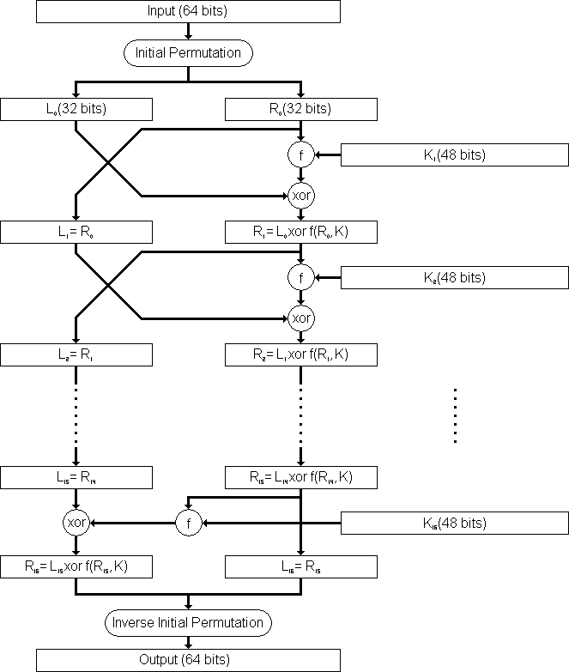
DES Algorithm/DES Structure/ Encryption of the DES (continued…):
Figure-1: Flow Diagram of DES algorithm for encrypting data.
Notes:
18

Slide 19
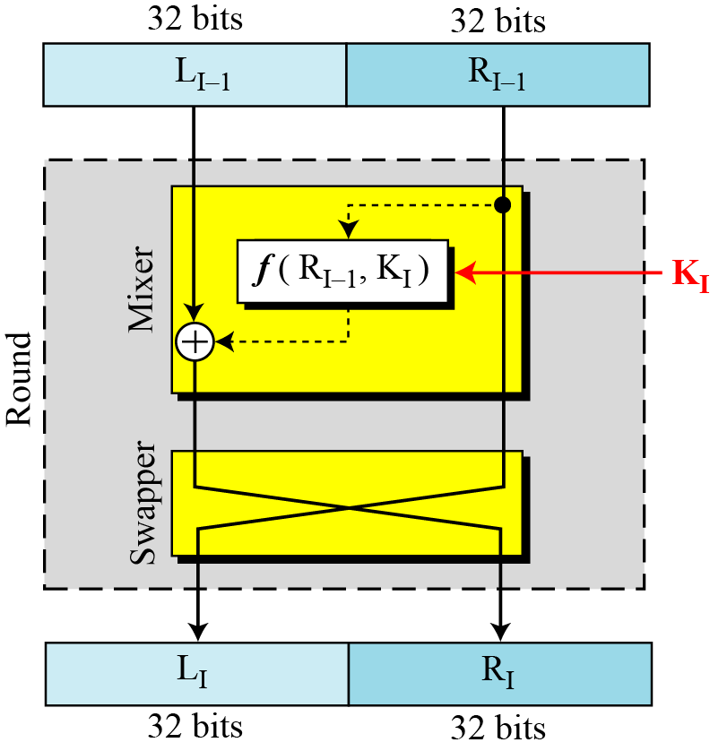
DES Rounds:
In DES, substitution and permutation are used a number of times in iterations called rounds. Generally, the more rounds there are, the more secure the algorithm is.
DES uses 16 rounds. Each round of DES is a Feistel cipher.
The round takes L_{i-1} and R_{i-1} from previous round (or the initial permutation box) and creates L_{i} and R_{i}, which go to the next round (or final permutation box).
Each round has two cipher elements: mixer and swapper. Each of these elements is invertible.
The swapper swaps the left half of the text with the right half. The mixer performs XOR operation.
Figure: A round in DES (encryption site)
Notes:
19

Slide 20
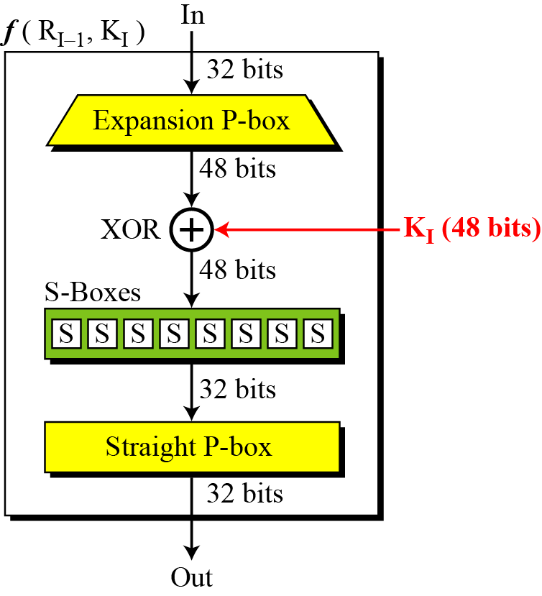
DES Round Function f(R_{i-1},K_{i}):
The heart of DES is DES round function.
The round function mixes the bits of the right (R) portion using the subkey for the current round.
It applies a 48-bit key to the rightmost 32 bits (R_{i-1}) to produce a 32-bit output.
All noninvertible elements in DES are collected inside the round function f(R_{i-1},K_{i})
This function is the main part of every round and consists of four sections:
1. An expansion P-box (E-box, for 32 bit to 48 bit conversion)
2. A whitener (Exclusive-or that adds key)
3. A group of S-boxes (for 48 bit to 32 bit conversion)
4. A straight permutation P-box
Figure: DES function
Notes:
20

Slide 21
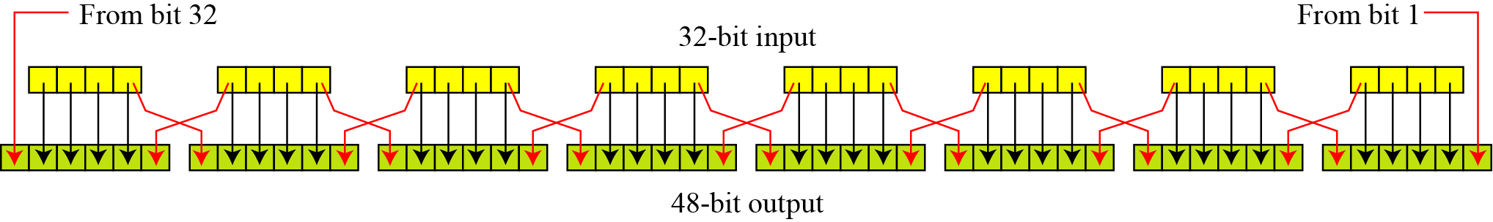
DES Round Function f(R_{i-1},K_{i}):
1. The E-box expansion permutation:
Since R_{i−1} is a 32-bit input and K_{i} is a 48-bit key, we first need to expand R_{i−1} to 48 bits.
To do this, the 32-bit R value is expanded to 48 bits using an expansion P-box permutation table E (shown in Table-1).
The expansion table defines a permutation plus an expansion.
Table-1: Expansion P-box table
Figure: Expansion permutation
Notes:
21

Slide 22
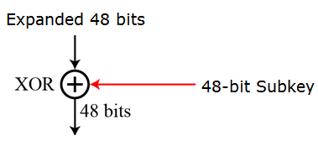
DES Round Function f(R_{i-1},K_{i}):
2. Whitener (Exclusive-or):
After the expansion permutation, DES uses the XOR operation on the expanded right section and the round key.
Note that both the right section and the key are 48-bits in length. Also note that the round key is used only in this operation.
That expanded value is then exclusive-or'ed with the 48-bit subkey.
Figure: Whitener
Notes:
22

Slide 23
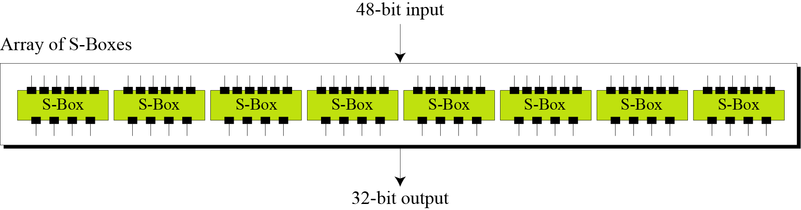
DES Round Function f(R_{i-1},K_{i}):
3. The S-boxes (substitute 48 bits to 32 bits):
In DES, a non-linearity is introduced into the encryption so that decryption will be computationally infeasible without the secret key. This is achieved with the use of S-boxes . which are basically non-linear substitution tables where either the output is smaller than the input or vice versa.
The S-boxes are the only non-linear operation in DES that do the real mixing (confusion).
DES uses 8 S-boxes, each with a 6-bit input and a 4-bit output, that is it accepts a 48-bit input and produces 32-bit number as output (defined in table-2).
The resulting 48 bits from whitener operation are divided into eight 6-bit chunks, each of which is fed into an S-Box that mixes the bits and produces a 4-bit output (The 8 S-boxes are shown in table-3). Those 4-bit outputs are combined into a 32-bit value.
The first and last bits of the 6-bit input of each S-box determine which column permutation is used. It provides non-linearity (confusion).
Figure: S-boxes
Notes:
23

Slide 24
DES Round Function f(R_{i-1},K_{i}):
4. Straight Permutation (P-box):
The combined 32 bits from the previous step are permuted once again to produce the 32 bits output of the f-function using expansion P-box table (Shown in Table-4).
Table-4: Straight permutation table
Notes:
24

Slide 25
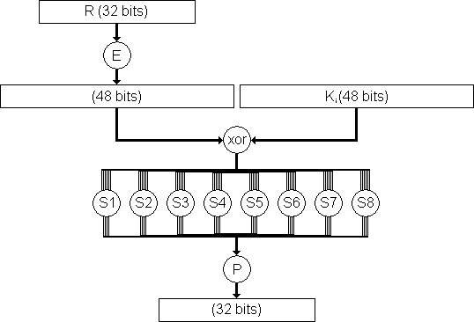
DES Round Function f(R_{i-1},K_{i}):
Figure below shows the DES round function f(x,k).
Figure-: The complex f(x,k) function of the DES algorithm.
Note:
The s-boxes provide the “confusion” of data and key values, whilst the permutation P then spreads this as widely as possible, so each S-box output affects as many S-box inputs in the next round as possible, giving “diffusion”.
Notes:
25

Slide 26
Modes of Operation in DES:
The DES algorithm is a basic building block for providing data security.
To apply DES in a variety of applications, five modes of operation have been defined which cover virtually all variation of use of the algorithm and these are shown in table-8 below.
Table-8: Modes of operation in DES
Notes:
26

Slide 27
What is AES (Advanced Encryption Standard):
The AES algorithm (also known as the Rijndael algorithm) is a symmetric block cipher algorithm that takes a block size of 128 bits and converts them into ciphertext using keys of 128, 192, and 256 bits.
11.27
Notes:
27

Slide 28
History of AES (Advanced Encryption Standard):
Until 2000, DES (Data Encryption Standard) had been used as a standard method of encryption, but with increase in speed in computers and having shorter key length, it is no more considered secure as a cryptanalyst can break the code by exhaustively searching for all the keys using a fast computer.
From 2001, DES has been replaced by a new standard known as the Advanced Encryption Standard (AES) which is published by the National Institute of Standards and Technology (NIST).
In 1997, NIST started looking for a replacement for DES, which would be called the Advanced Encryption Standard or AES.
The NIST specifications required a block size of 128 bits and three different key sizes of 128, 192, and 256 bits.
The specifications also required that AES be an open algorithm, available to the public worldwide. The announcement was made internationally to solicit responses from all over the world.
After the First AES Candidate Conference, NIST announced that 15 out of 21 received algorithms had met the requirements and been selected as the first candidates (August 1998).
Algorithms were submitted from a number of countries; the variety of these proposals demonstrated the openness of the process and worldwide participation.
11.28
Notes:
28

Slide 29
History of AES (Advanced Encryption Standard):
After the Second AES Candidate Conference, which was held in Rome, NIST announced that 5 out of 15 candidates—MARS, RC6, Rijndael, Serpent, and Twofish— were selected as the finalists (August 1999).
After the Third AES Candidate Conference, NIST announced that Rijndael designed by Belgian researchers Joan Daemen and Vincent Rijment, was selected as Advanced Encryption Standard (October 2000).
In February 2001, NIST announced that a draft of the Federal Information Processing Standard (FIPS) was available for public review and comment.
Finally, AES was published as FIPS 197 in the Federal Register in December 2001.
11.29
Notes:
29

Slide 30
Features of AES:
The features that make AES a unique algorithm are:
It uses Substitution and Permutations, also called SP Networks.
A single key is expanded to be used in multiple rounds.
AES performs on byte data, instead of bit data.
No. of rounds is dependent on key length.
Three different key length:
128-bit Key Length uses 10 rounds
192-bit Key Length uses 12 rounds
256-bit Key Length uses 14 rounds
11.30
Notes:
30

Slide 31
Criteria Defined by NIST for AES:
The criteria defined by NIST for selecting AES fall into three areas:
Security:
The main emphasis was on security. Because NIST explicitly demanded a 128-bit key, this criterion focused on resistance to cryptanalysis attacks other than brute-force attack.
Cost:
The second criterion was cost, which covers the computational efficiency and storage requirement for different implementations such as hardware, software, or smart cards.
Implementation:
The third criterion was implementation. This criterion included the requirement that the algorithm must have flexibility (be implementable on any platform) and simplicity. It also required that AES be an open algorithm, available to the public worldwide.
At the end, Rijndael was judged the best at meeting the combination of these criteria.
11.31
Notes:
31

Slide 32
Parameters for Three Versions of AES:
AES is a non-Feistel cipher (i.e., it uses only invertible components).
In AES, there is no need to divide the plaintext into two halves as we saw in the Feistel ciphers like DES.
AES is a block cipher that encrypts and decrypts data as a block of 128 bits.
It uses 10, 12, or 14 rounds.
Three different key sizes of 128, 192, and 256 bits can be used which depends on the number of rounds.
AES has defined three versions with 10, 12, and 14 rounds. The versions are referred as AES-128, AES-192, and AES-256.
Each version uses a different cipher key size (128, 192, or 256 bits), but the round keys (which are created by the key-expansion algorithm) are always 128 bits which is the same size as the plaintext or ciphertext block.
11.32
Notes:
32

Slide 33
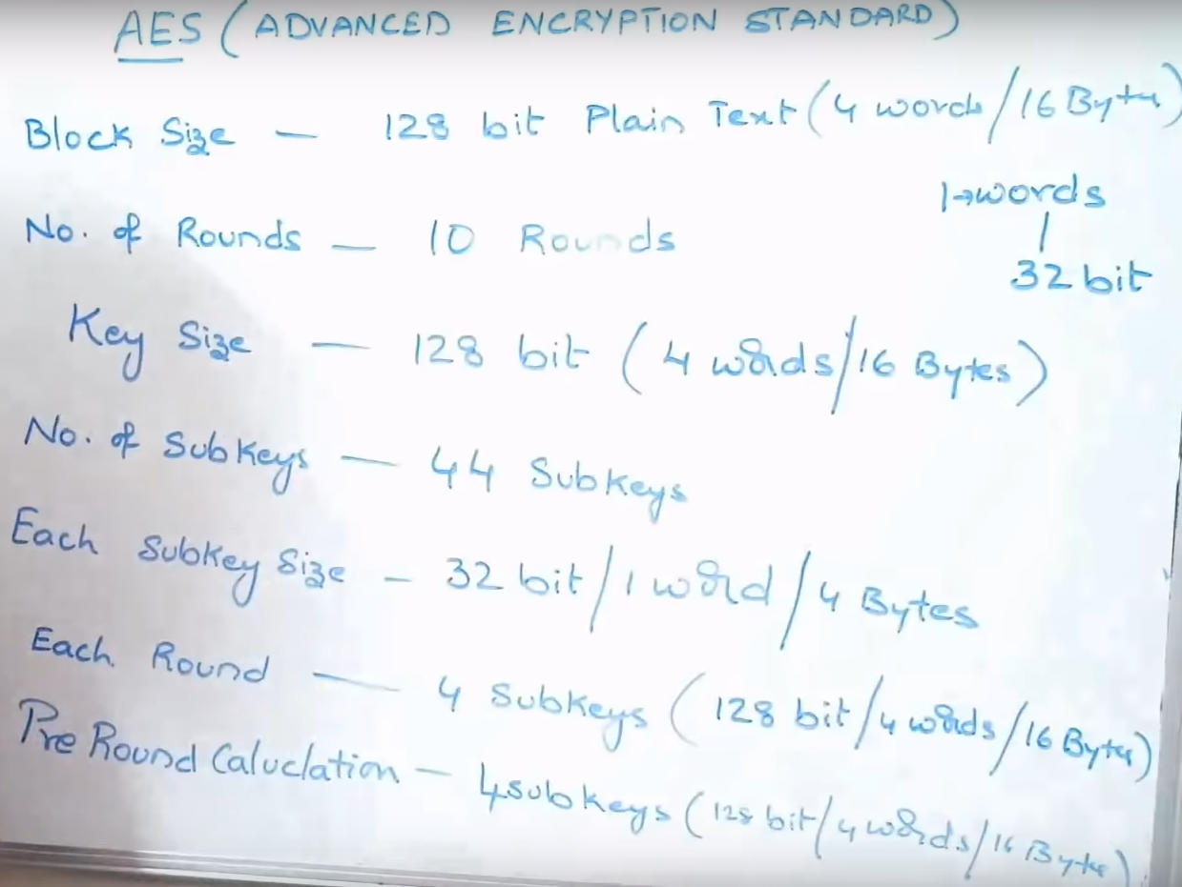
Common Parameters about AES:
11.33
Notes:
33

Slide 34
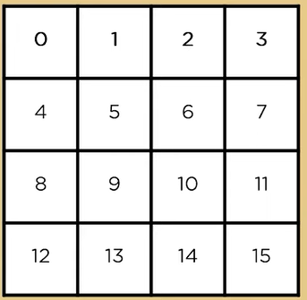
Manner of Storing Input Data: Block-to-State Conversion
Let us know how data is being stored during the process of AES encryption.
The plaintext block to be encrypted is just a sequence of 128 bits.
AES works with byte quantities. So at first, we convert the 128 bits into 16 bytes.
These 16 bytes of plaintext data is arranged in a 4 x 4 matrix format which is known as state array.
Each round takes the state array as input and gives corresponding output of 4 x 4 matrix.
At the start of the encryption, the 16 bytes of data, numbered are loaded into the array as shown in Table where each cell corresponds to one byte.
4 bytes (i.e., 32 bits) make one word, so each state array has 4 words.
11.34
Notes:
34

Slide 35
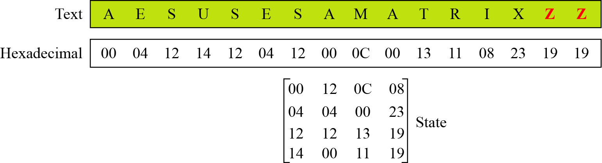
Manner of Storing Input Data: Block-to-State Conversion
Example:
Let us see how a 16-character block can be shown as a 4 x 4 matrix.
Assume that the text block is “AES uses a matrix”.
We add two bogus characters at the end to get “AESUSESAMATRIXZZ”.
Now we replace each character with a decimal integer between 00 and 25.
We then show each byte as an integer with two hexadecimal digits. For example, the character “S” is first changed to 18 and then written as 12₁₆ in hexadecimal. The state matrix is then filled up, column by column, as shown in the figure below.
11.35
Figure: Changing plaintext to state
Notes:
35

Slide 36
Steps in AES Encryption Process
The AES encryption process uses a set of specially derived keys called round keys. Along with other operations, these round keys are applied on an array of data that holds exactly one block of data that is to be encrypted.
The steps in the encryption of AES 128-bit block are listed below:
Derive the set of round keys from the cipher key.
Initialize the state array with the block data (plaintext).
Add the initial round key to the starting state array.
Perform nine rounds of state manipulation.
Perform the tenth and final round of state manipulation.
Note:
The reason that the rounds have been listed as "nine followed by a final tenth round" is because the tenth round involves a slightly different manipulation from the others.
11.36
Notes:
36

Slide 37
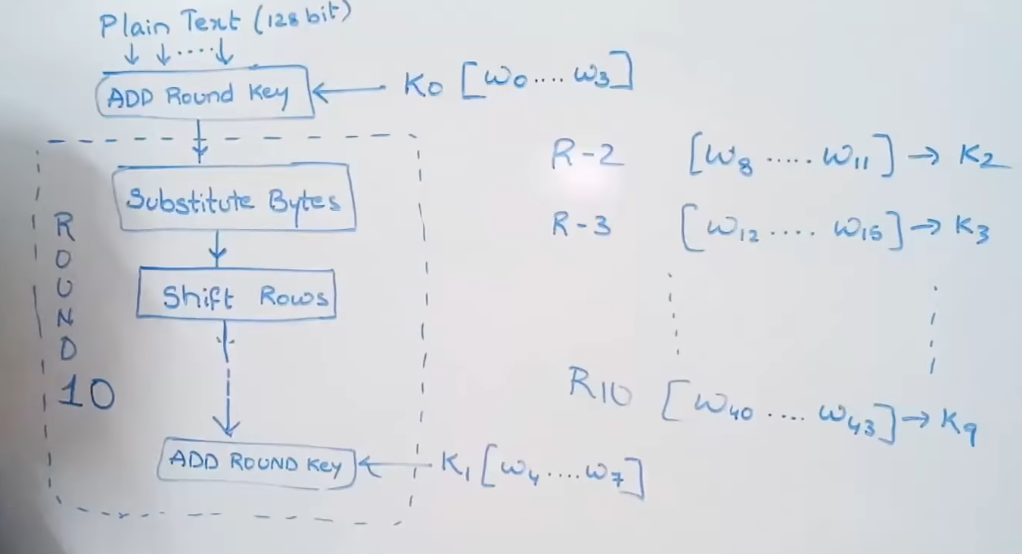
Simplified Block Diagram of AES
Notes:
37

Slide 38
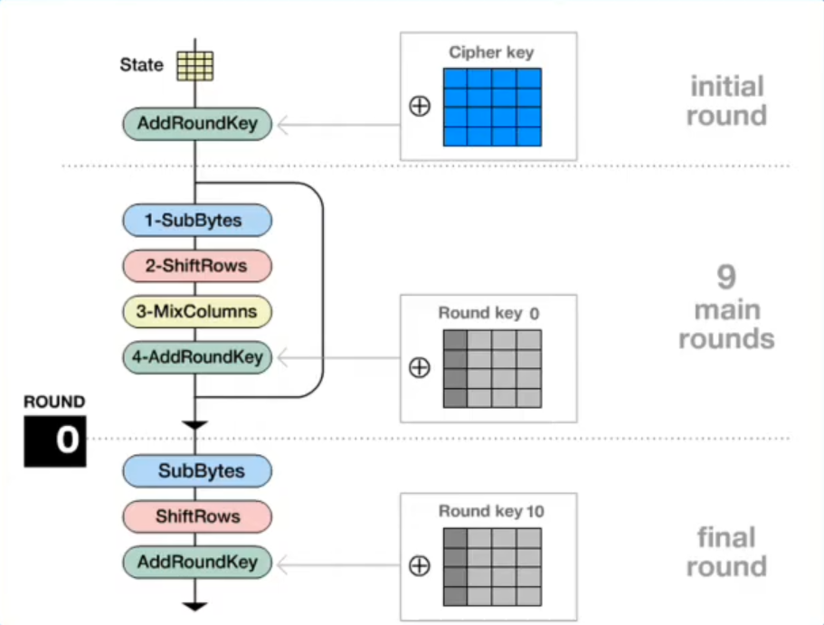
Simplified Block Diagram of AES
Four operations are required in each round:
11.38
Notes:
38

Slide 39
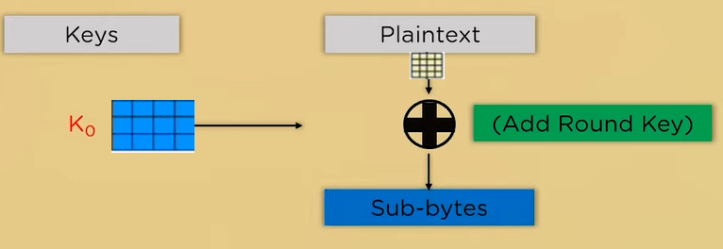
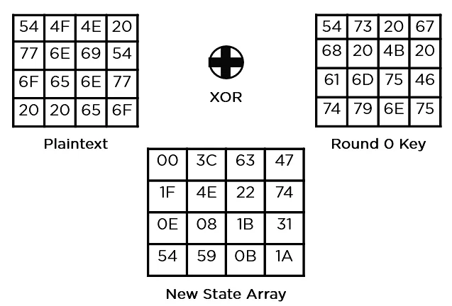
Pre-round Operations in AES
In the very beginning, the plaintext state array is Exor-ed with the initial round key K₀.
The output is passed to a byte substitution process.
Example:
54 = 01010100
54 = 01010100
00 = 00000000
77 = 01110111
68 = 01101000
1F = 00011111
11.39
Notes:
39

Slide 40
Round Operations in AES
Following four operations are required to perform in round-1 to round-9:
SubBytes
ShiftRows
MixColumns
XorRoundKey
In the final round (10th round), following three operations are required to perform
SubBytes
ShiftRows
XorRoundKey
11.40
Notes:
40

Slide 41
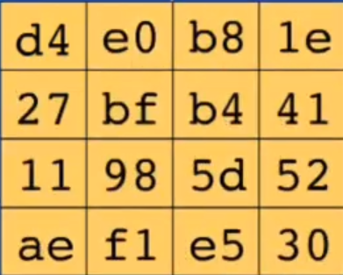
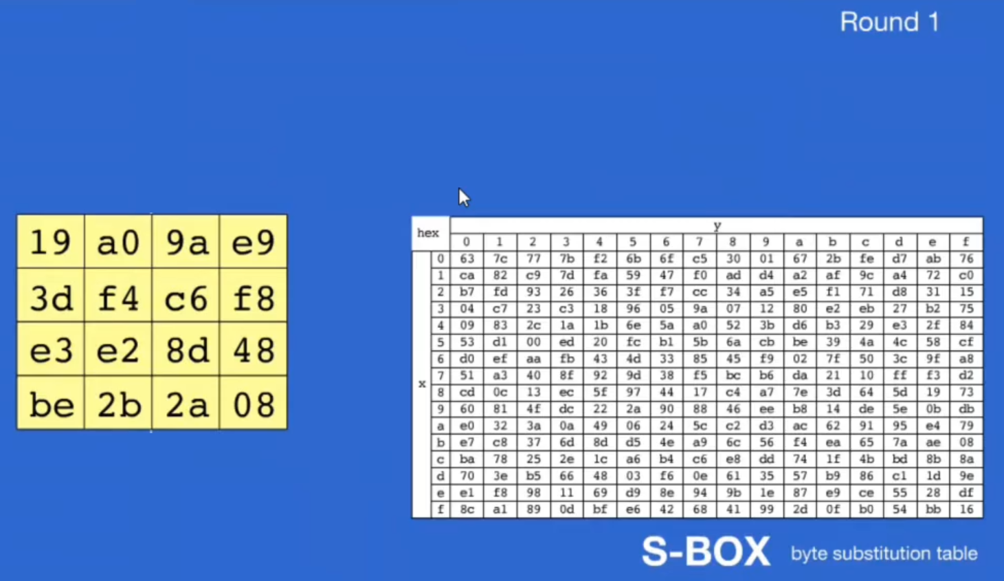
1. SubBytes Operations
State Matrix after SubBytes Operation
State Matrix before SubBytes Operation
11.41
Notes:
41

Slide 42
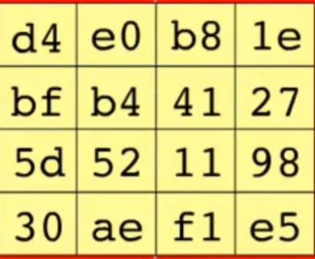
2. ShiftRows Operation
Row 0: Rotate each byte from right to left over 0 byte
Row 1: Rotate each byte from right to left over 1 byte
Row 2: Rotate each byte from right to left over 2 byte
Row 3: Rotate each byte from right to left over 3 byte
State Matrix before ShiftRows Operation
11.42
State Matrix after ShiftRows Operation
Notes:
42

Slide 43
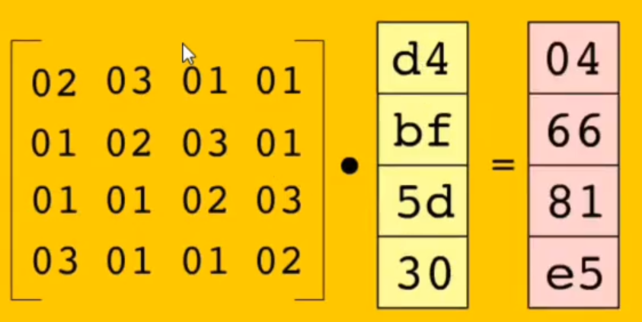
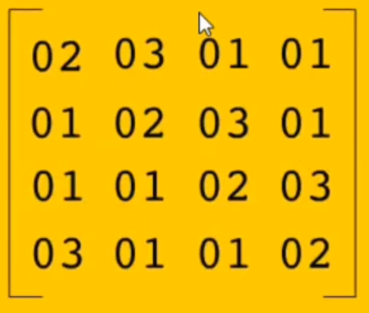
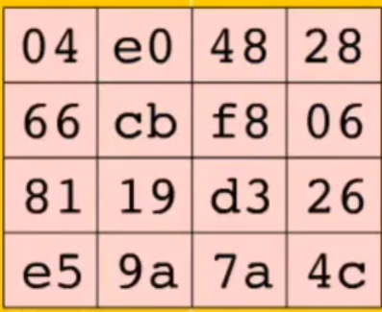
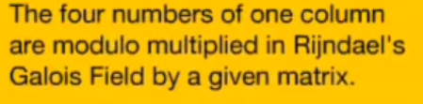
3. MixColumn Operation:
State Matrix before MixColumn Operation
11.43
State Matrix after MixColumn Operation
Notes:
43

Slide 44
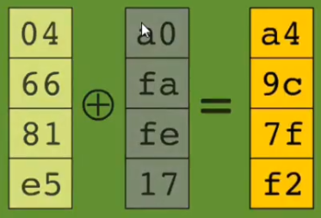
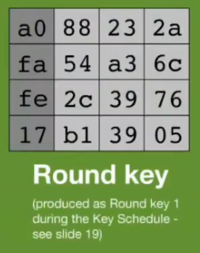
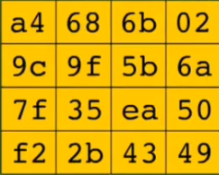
4. AddRoundKey Operation:
State Matrix before AddRoundKey Operation
11.44
State Matrix after AddRoundKey Operation
Notes:
44

Slide 45
AES Key Expansion
To create round key for each round, AES uses a key-expansion process.
The cipher key is expanded to n + 1 rounds, with n being the number of rounds.
The first round key is used for pre-round transformation (AddRoundKey); the remaining round keys are used for the last transformation (AddRoundKey) at the end of each round.
4 words in each key.
Each key is used for a single round. The first key is used as initial round key before any round begins.
11.45
Notes:
45

Slide 46
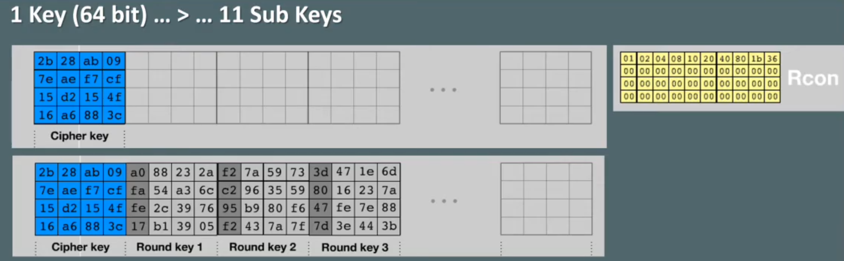
Key Schedule Algorithm in AES-128:
Rcon = A Constant Table
11.46
Notes:
46

Slide 47
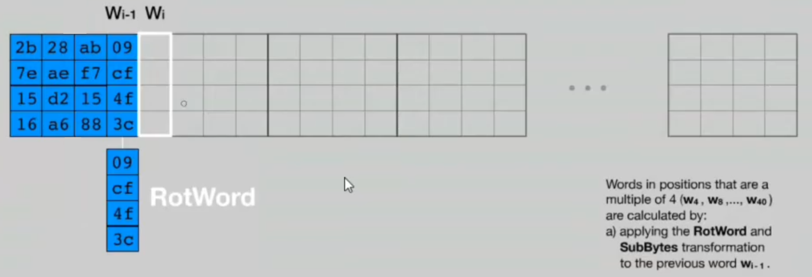
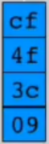
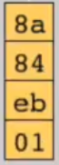
Key Schedule Algorithm in AES-128:
Substitute these values by the S-box
After rotation
11.47
After substitution
Notes:
47

Slide 48
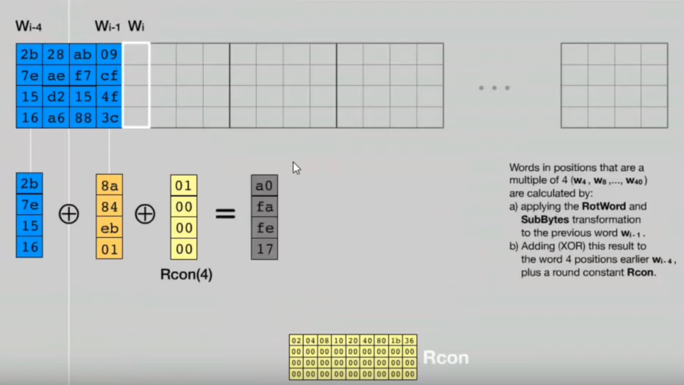
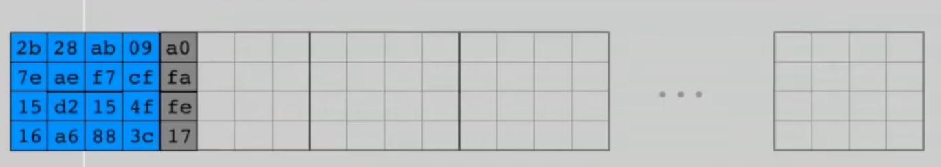
Key Schedule Algorithm in AES-128:
11.48
Notes:
48

Slide 49
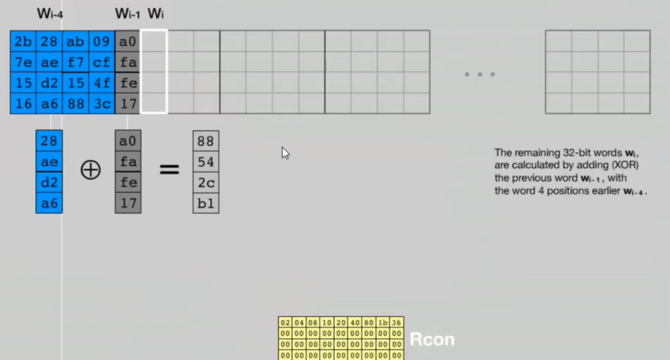
Key Schedule Algorithm in AES-128:
11.49
Notes:
49

Slide 50
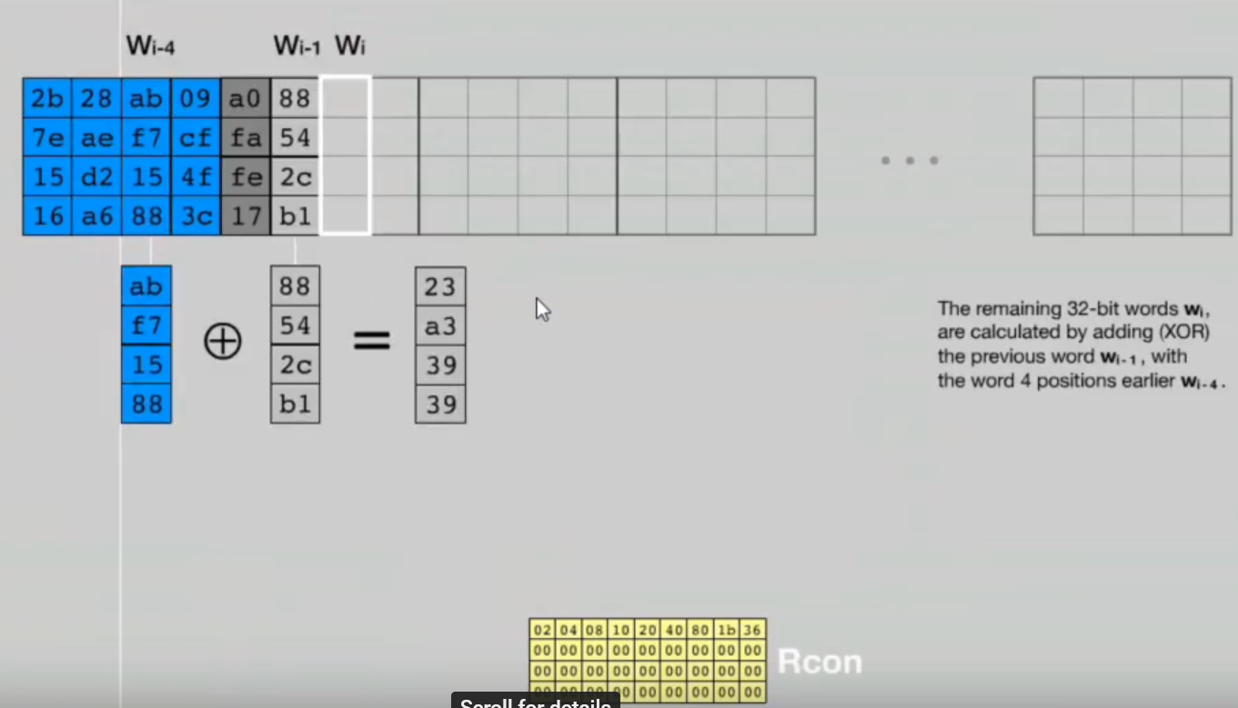
Key Schedule Algorithm in AES-128:
11.50
Notes:
50

Slide 51
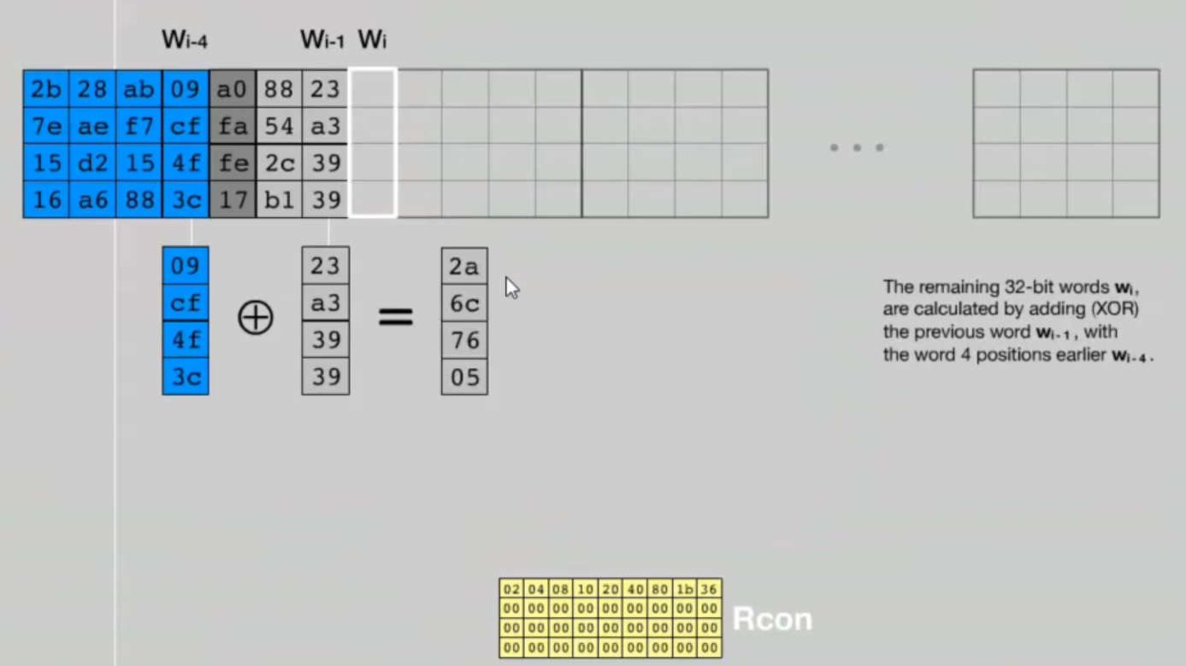
Key Schedule Algorithm in AES-128:
11.51
Notes:
51

Slide 52
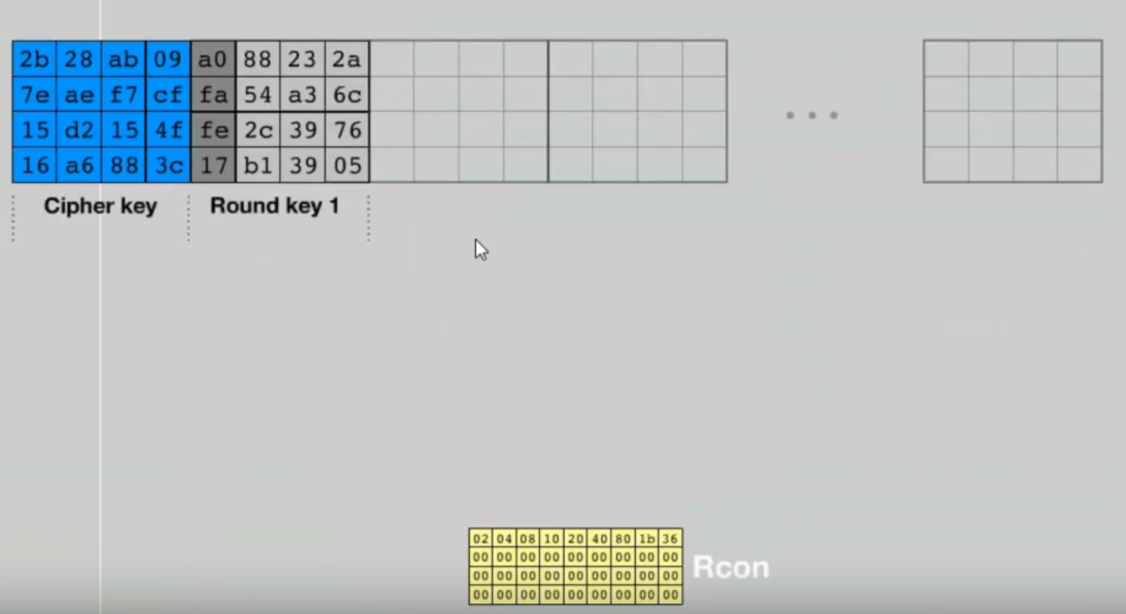
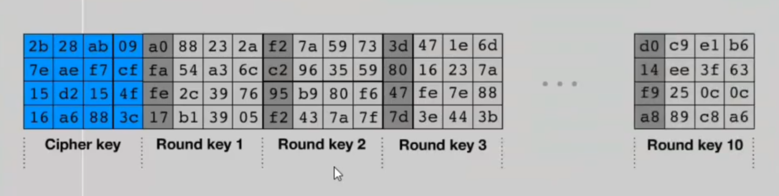
Key Schedule Algorithm in AES-128:
11.52
Notes:
52

Slide 53
Transformations in AES:
To provide security, AES uses four types of transformations:
Substitution
Permutation
Mixing
Key-adding
Each round of AES, except the last, uses the four transformations. The last round uses only three of the four transformations (Mixing transformation is missing).
11.53
Notes:
53

Slide 54
Transformations in AES:
1) Substitution:
AES, like DES, uses substitution. However, the mechanism is different.
First, the substitution is done for each byte.
Second, only one table is used for transformation of every byte, which means that if two bytes are the same, the transformation is also the same.
Third, the transformation is defined by either a table lookup process or mathematical calculation in the GF(2⁸) field.
AES uses two invertible transformations, SubBytes and InvSubBytes, which are inverses of each other.
11.54
Notes:
54

Slide 55
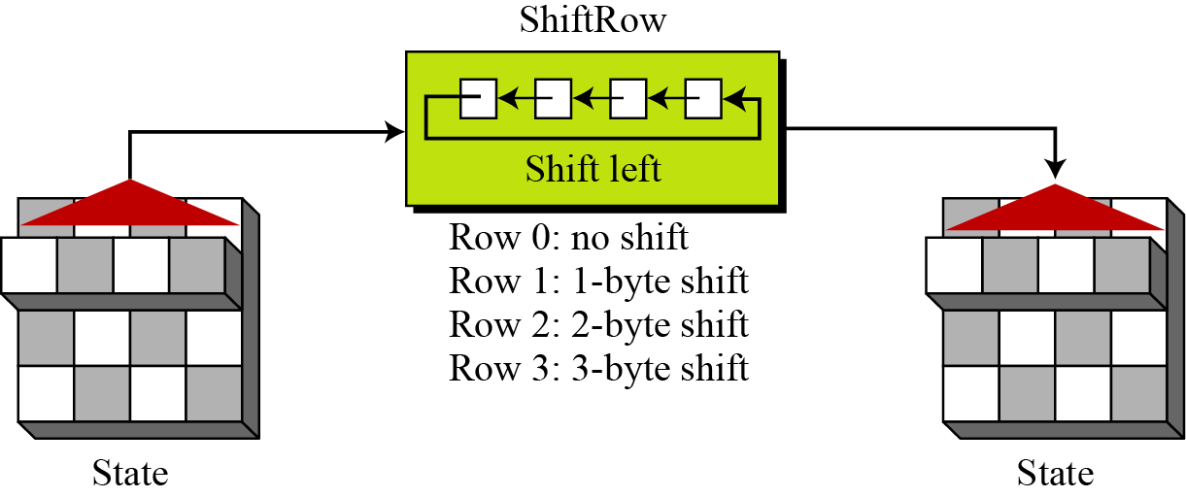
Transformations in AES:
2) Permutation:
The second transformation in a round is shifting, which permutes the bytes.
Unlike DES, in which permutation is done at the bit level, shifting transformation in AES is done at the byte level; the order of the bits in the byte is not changed.
In the encryption, the transformation is called ShiftRows. In the decryption, the transformation is called InvShiftRows. The ShiftRows and InvShiftRows transformations are inverses of each other.
In ShiftRows, the shifting is to the left. The number of shifts depends on the row number (0, 1 , 2, or 3) of the state matrix. This means the row 0 is not shifted at all and the last row is shifted three bytes. Figure below shows the shifting transformation.
11.55
Figure: ShiftRows transformation
Notes:
55

Slide 56
Transformations in AES:
3) Mixing:
The mixing transformation changes the contents of each byte by taking four bytes at a time and combining them to recreate four new bytes.
AES defines two mixing transformations, MixColumns and InvMixColumns, to be used in the encryption and decryption.
MixColumns multiplies the state matrix by a constant square matrix; the InvMixColumns does the same using the inverse constant matrix.
The MixColumns and InvMixColumns transformations are inverses of each other.
11.56
Notes:
56

Slide 57
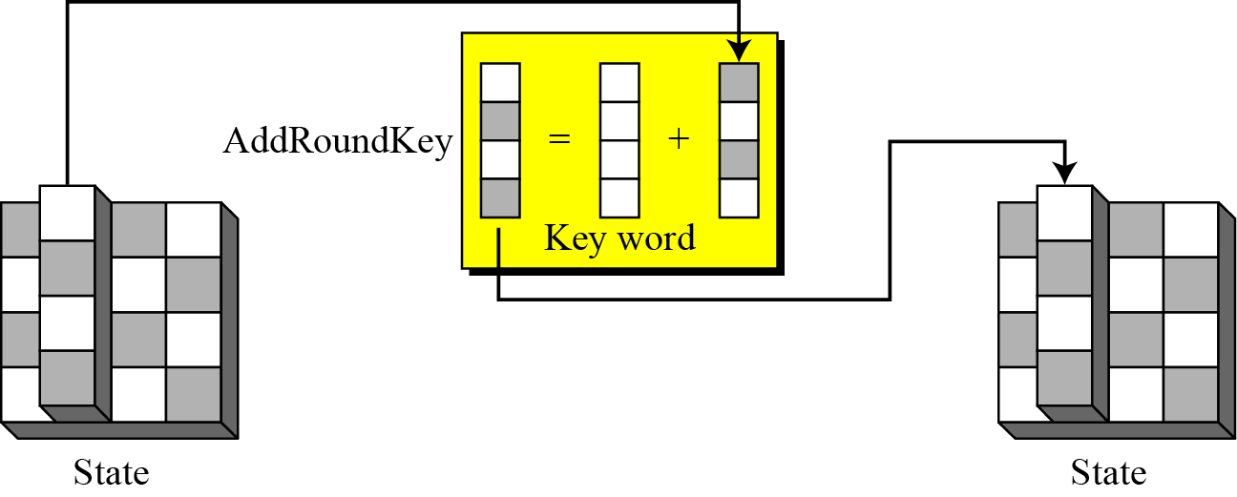
Transformations in AES:
4) Key-adding:
The transformation that performs whitening is called AddRoundKey.
The previous state is added (matrix addition) with the round matrix key to create the new state.
Addition of individual elements in the two matrices is done in GF(2⁸) which means that 8-bit words are XORed.
The AddRoundKey transformation is the inverse of itself.
11.57
Figure: AddRoundKey transformation
Notes:
57

Slide 58
RSA Cryptosystem
RSA is the most commonly used public-key cryptography algorithm, which uses prime factorization as the trapdoor one-way function. That is, it is based on the presumed difficulty of factoring large integers.
It is named so after the surnames of its inventors Ron Rivest, Adi Shamir, and Leonard Adleman of the Massachusetts Institute of Technology (MIT).
It was first published in 1978.
This algorithm relies on one way function. A one way function is easy to compute but hard to invert. For example it is easy to take the product of two prime numbers but given the product, it is difficult to split it into the original prime factors.
This algorithm lets you choose the size of your public key.
The 512-bit keys are considered insecure or weak, but the 768-bit keys are secure from everything but the National Security Administration (NSA).
The 1024-bit keys are secure from everything virtually.
RSA is embedded in major products such as Windows, Netscape Navigator etc.
Notes:
58

Slide 59
How the RSA Cryptosystem Works?
Briefly, the RSA algorithm involves multiplying two large prime numbers P and Q and through additional operations deriving a set of two numbers e and d where e is the public key and d is the private key.
Once the keys have been developed, the original prime numbers are no longer important and can be discarded. Both the public and the private keys are needed for encryption /decryption but only the owner of a private key ever needs to know it. Using the RSA system, the private key never needs to be sent across the Internet.
Anyone can use the public key to encrypt a message. But the message can be decrypted only by the owner of the private key.
Thus, if Alice wants to send a message to Bob, she can find out Bob’s public key (but not his private key) from a central administrator.
After getting the public key of Bob, Alice then encrypt the message using Bob’s public key and sends the encrypted message to Bob.
When Bob receives it, he decrypts it with his private key.
In addition to encrypting messages (which ensures privacy), Bob can authenticate himself to Alice (so Alice knows that it is really Bob who sent the message) by using Bob’s private key to encrypt a digital certificate. When Alice receives it, she can use Bob’s public key to decrypt it.
Notes:
59

Slide 60
Steps in RSA Algorithm
The RSA algorithm involves three steps:
Key generation (Generating public and private key)
Encryption (Encrypting the message)
Decryption (Decrypting the message)
RSA involves a public key and a private key.
The public key can be known by everyone and is used for encrypting messages.
Messages encrypted with the public key can only be decrypted in a reasonable amount of time using the private key.
Notes:
60

Slide 61
RSA Algorithm: Key Generation
The keys for the RSA algorithm are generated by the following ways:
Choose two large and distinct prime numbers p and q.
For security purposes, the integers p and q should be chosen at random, and should be of similar bit-length.
In RSA, p and q must be at least 512 bits; n must be at least 1024 bits.
Prime integers can be efficiently found using a primality test.
Compute n = p * q
n is used as the modulus for both the public and private keys. Its length, usually expressed in bits, is the key length.
Compute the number of integers less than n that are coprime with n (otherwise known as the totient or Euler’s Phi function):
φ(n) = φ(p*q) = φ(p)* φ(q)=(p - 1) * (q – 1)
Choose an integer e such that 1 < e < φ(n) and gcd(e, φ(n)) = 1; i.e. e and φ(n) are coprime.
e is released as the public key exponent (encryption exponent).
e having a short bit-length results in more efficient encryption– most commonly 2¹⁶ + 1 = 65,537. However, much smaller values of e (such as 3) have been shown to be less secure in some settings.
Notes:
61

Slide 62
RSA Algorithm: Key Generation
Determine the multiplicative inverse d of e; i.e., compute a value for d such that it satisfies the relation: (d * e) mod φ(n) = 1
d is kept as the private key exponent (decryption exponent).
d is often computed using the Extended Euclidean Algorithm.
d must be kept secret.
p, q, and φ(n) must also be kept secret because they can be used to calculate d.
The public key consists of the modulus n and the public key exponent e; i.e., the public key is (e, n).
The private key consists of the modulus n and the private key exponent d; i.e., the private key is (d, n).
To encrypt message m using the public key, use the relation:
c = m^{e} mod n
To decrypt c using the private key, use the relation:
m = c^{d} mod n
Notes:
62

Slide 63
RSA Algorithm: Encryption
Bob transmits his public key (e, n) to Alice and keeps the private key (d, n) secret.
Alice then wishes to send message M to Bob.
The message is encrypted by the following ways:
Alice first turns message M into an integer m, such that 0 ≤ m < n.
That is, the message is represented as an integer between 0 and (n-1).
Large messages can be broken up into a number of blocks. Each block would then be represented by an integer in the same range.
After turning the message into integer, Alice then computes the ciphertext c using the following relation:
c = m^{e} mod n
After computing ciphertext, Alice then transmits c to Bob.
Notes:
63

Slide 64
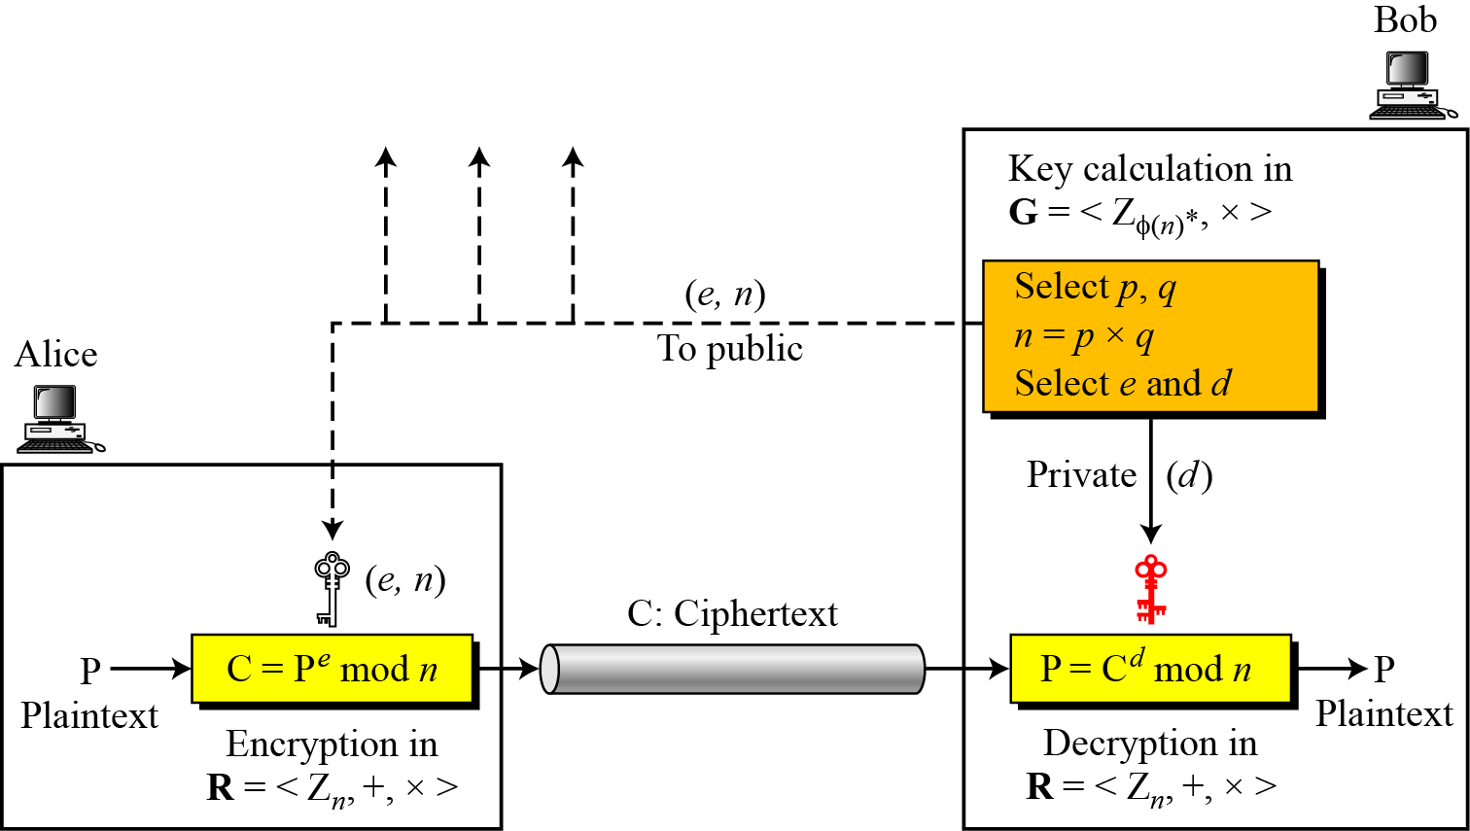
RSA Algorithm: Decryption
Bob can recover m from c by using his private key exponent d using the following relation:
m = c^{d} mod n
After having m, Bob can recover the original message M by reversing the padding scheme.
The encryption, decryption and key generation in RSA
is shown in the figure below.
Figure: Encryption, decryption, and key generation in RSA
Notes:
64

Slide 65
RSA Cryptosystem: Trivial Examples
Example-1:
Choose p = 3 and q = 11
Compute n = p * q = 3 * 11 = 33
Compute φ(n) = φ(p*q) = φ(p)* φ(q)=(p - 1) * (q - 1) = 2 * 10 = 20
Choose e such that 1 < e < φ(n) and e and φ(n) are coprime. We have several choices for e: 7, 11, 13, 17, 19. (We cannot use 5 as e, because 20 is divisible by 5). Let e = 7
Compute a value for d such that (d * e) mod φ(n) = 1. One solution is d = 3 [(3 * 7) % 20 = 1] [d is the multiplicative inverse of e]
Public key is (e, n) => (7, 33)
Private key is (d, n) => (3, 33)
The encryption of m = 2 is c = m^{e} mod n = 2⁷ mod 33 = 29
The decryption of c = 29 is m = c^{d} mod n = 29³ mod 33 = 2
Notes:
65

Slide 66
RSA Cryptosystem: Trivial Examples
Example-2:
Bob chooses 7 and 11 as p and q.
He calculates n = 77. The value of φ(n) = (7 − 1)(11 − 1) or 60.
Now he chooses two exponents, e and d, from Z₆₀∗. If he chooses e to be 13, then d is 37. Note that e × d mod 60 = 1 (they are inverses of each).
Now imagine that Alice wants to send the plaintext 5 to Bob. She uses the public exponent 13 to encrypt 5.
Bob receives the ciphertext 26 and uses the private key 37 to decipher the ciphertext:

Slide 67
RSA Cryptosystem: Trivial Examples
Example-3:
Now assume that another person, John, wants to send a message to Bob.
John can use the same public key announced by Bob (probably on his website), 13.
John’s plaintext is 63. John calculates the following:
Bob receives the ciphertext 28 and uses his private key 37 to decipher the ciphertext:

Slide 68
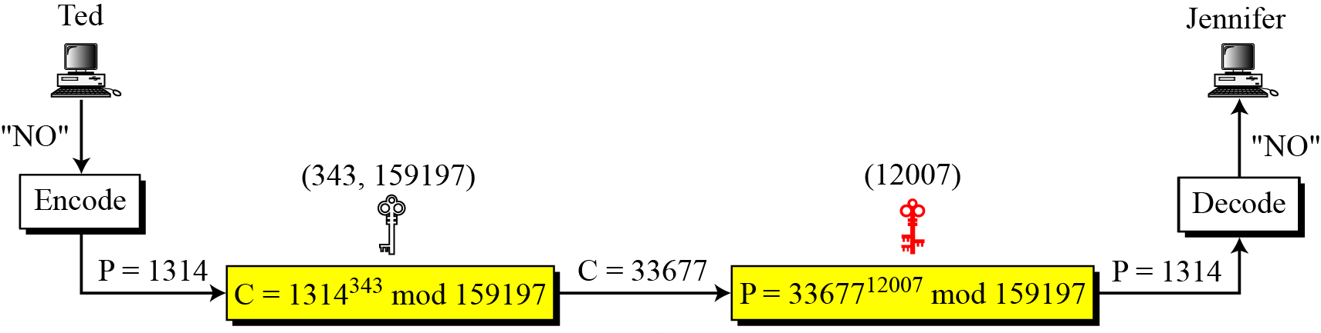
RSA Cryptosystem: Trivial Examples
Example-4:
Jennifer creates a pair of keys for herself. She chooses p = 397 and q = 401.
She calculates n = 159197. She then calculates φ(n) = 158400. She then chooses e = 343 and d = 12007.
Show how Ted can send a message to Jennifer if he knows e and n.
Solution:
Suppose Ted wants to send the message “NO” to Jennifer.
He changes each character to a number (from 00 to 25), with each character coded as two digits.
He then concatenates the two coded characters and gets a four-digit number. The plaintext is 1314.
He then uses e and n to encrypt the message.
Figure below shows the process.

Slide 69
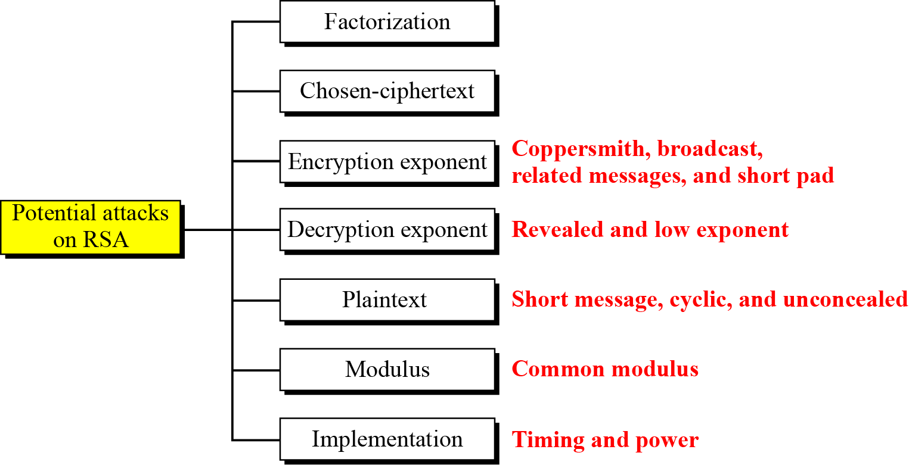
Attacks on RSA Cryptosystem
No devastating attacks on RSA have been yet discovered.
Several attacks have been predicted based on the weak plaintext, weak parameter selection, or inappropriate implementation.
Figure below shows the category of potential attacks on RSA.
Figure: Taxonomy of potential attacks on RSA

Slide 70
RSA Cryptosystem: Cracking the Code
The essential requirement of the Public Key Cryptography, like RSA, is that-the public and secret keys are mathematically related, but this relationship must be made very hard to determine by an outsider.
As we saw in the preceding text, everything starts with p and q, from which we calculated n.
The public key consists of two numbers: e and n, where e is calculated from φ(n), and φ(n) is calculated from p and q.
The secret key d, was calculated from e and φ(n) and, as we just stated, e and φ(n) are calculated from p and q.
It follows then, that d is also calculated from p and q, which proves that the public and private keys are mathematically related.
So, if an adversary (like Eve) wanted to find the secret key d, by only knowing n, he must break down n into the two prime numbers that were used to produce it (remember that n = p * q).
Now, here is the real crux of the bisquit: Decomposing a very large n into p and q is really difficult to do. It is easy with the small numbers that we have used in our demonstration, but, for example, if 100 digit numbers are used for p and q, the resulting n will be approximately 200 digits. Then decomposing n into p and q will be very hard. The fastest known factoring algorithm would take far too long for an attacker to ever break the code.
Well, if you have some free time on your hands, try this challenge: n=13289. Find p and q. If you can find, you may even earn some money.
Any cryptographic technique which can resist a concerted attack is regarded as secure. At this point in time, the RSA algorithm is considered secure.
Notes:
70

Slide 71
RSA Cryptosystem
In RSA cryptosystem, encryption using public keys is normally computationally intensive. So, in practice-
The sender encrypts the message with a secret key that is randomly generated.
The secret key is encrypted using the public key of the recipient and sent with the encrypted message.
The recipient decrypts the secret key using his private key and using that secret key, he decrypts the rest of the message.
The following lists all the steps in the process:
The client and server go through a handshaking procedure.
The handshake begins when the client connects to a SSL enabled server requesting a secure connection and presents a list of encryption algorithms and hash functions that it supports.
From this list the server chooses the most secure encryption algorithm and hash function that it also supports and lets the client know about its choice.
In the above transaction, the server also sends it identification in the form of a digital certificate. The digital certificate contains the server's name, the trusted Certificate Authority, and the server's public encryption key.
The client may contact the trusted Certificate Authority for verification.
The client generates a random number and encrypts it with the server's public key and sends it to the server. Only the server can decrypt this with its private key.
The random number generated by the client is then used in the encryption and decryption process on both the client and server sides.
Notes:
71

Slide 72
RSA Cryptosystem: Applications
Although RSA can be used to encrypt and decrypt actual messages, it is very slow if the message is long.
Therefore, RSA is useful for short messages.
RSA is used in digital signature and other cryptosystems that often need to encrypt a small message without having access to a symmetric key.
RSA is also used for authentication.
Notes:
72

